Slide 1





SPRING & SPRING BOOT
LECTURE - 1

Slide 2

Today’s Agenda
Pre Requisites
What is a Framework ?
Framework Vs Library
Types of Frameworks
Introduction to Spring Framework
Course Content

Slide 3
What you should know ?
Core Java
OOP basics
Specially Inheritance, Polymorphism and Interface
Exception Handling
Collections
JDBC
Basic knowledge of Servlet

Slide 4
What is a Programming Language ?
Communication medium between humans and computers.
Provides syntaxes and semantics .
Used to develop softwares apps, technologies, libraries and even frameworks .
Examples: C, C++, Java, C#, Kotlin, Scala, Python etc

Slide 5
What is a Library ?
A collection of predefined methods, classes or interfaces used for solving common problem.
Come either bundled with a language or can be downloaded from the internet and used.
Examples of Libraries –
Standard Libraries : java.lang, java.util, java.io
3rd Party Libraries : apache commons, twilio, iText

Slide 6
Benefits of Library ?
Reusability
Reduces Programmer’s efforts
Allows a programmer to focus on main problem.

Slide 7


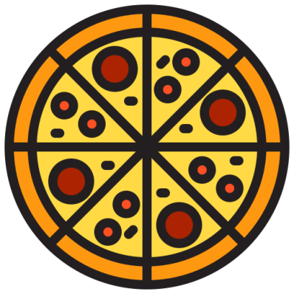
A Real-Life Example
Imagine, a chef needs to make a Pizza

Slide 8





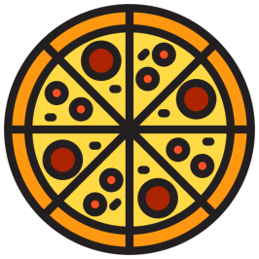


Making a Pizza
Stretch it using rolling pin
Cut it using Pizza Cutter
Prepare a dough
These tools are like a Library
Job Done !!
Bake it in an Oven

Slide 9
What is a Framework ?
Collection of multiple Libraries.
Provides foundation on which we can build our code.
It provides pre-written common logics so that we can focus on business logic only.
Provides reusable components

Slide 10
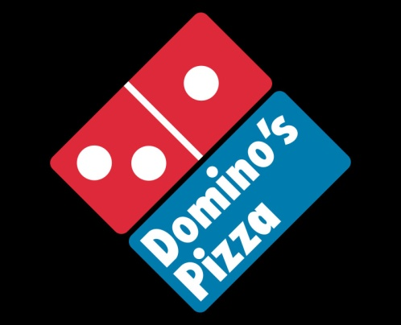

A Real-life Example
Imagine, how DOMINOS makes Pizza ?

Slide 11

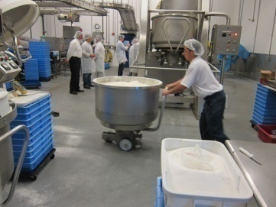
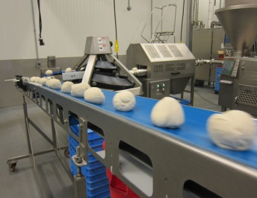



Dominos Pizza Making
Put Ingredients in a Dough Machine
Dough Machine will produce Dough Balls
Stretching & Cutting using Pizza Cutter Machine
This Pizza Factory is a Framework
Job Done !!
Bake in Pizza Oven

Slide 12
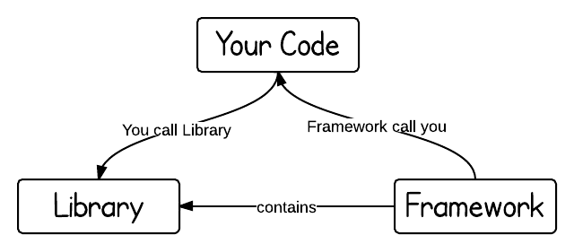
Library Vs Framework
Libraries are focused to a specific task only while a framework has a wide range of functionality and used to build complete application.
Our code calls the Library, while in case of framework it calls our code.

Slide 13
Benefits
Speeds up Development Process
Secure
Forces us to follow standard programming practices and thus make our code clean.

Slide 14
Web Application Architecture
USER INTERFACE
WEB LAYER
BUSINESS LAYER
DAO
(Code for DB Access)
DATABASE
Backend Application
Frontend Application

Slide 15

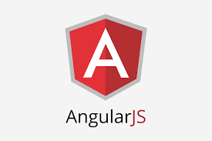


Types of Frameworks
2
WEB FRAMEWORK
FRONTEND FRAMEWORK
1
Types
Of
Frameworks
3
APPLICATION DEVELOPMENT FRAMEWORK
ORM FRAMEWORK
4
03 - SOCIAL MEDIA

Slide 16
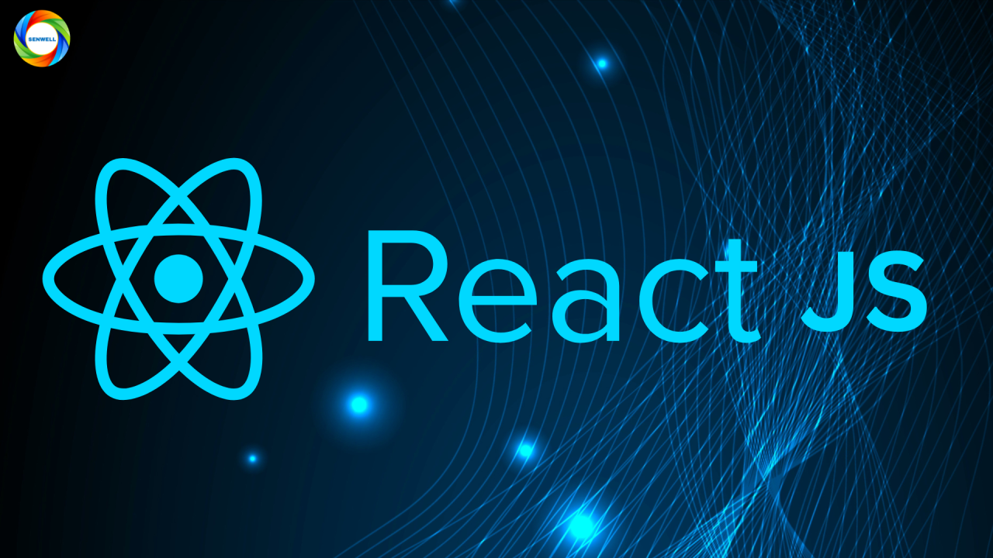
Web Application Architecture
BUSINESS LAYER
DAO
DATABASE
USER INTERFACE
WEB LAYER
Backend Application
Frontend Application

Slide 17
Web Application Architecture
BUSINESS LAYER
DAO
DATABASE
USER INTERFACE
WEB LAYER
Backend Application
Frontend Application

Slide 18
Introduction to Spring Framework
Spring is the most popular Java framework for building any type of Java application.
Popularly called Framework of Frameworks.
Spring is free & open-source framework
Spring is developed in modular fashion.
Commonly used as ‘backend’ technology
Over 87% of the companies using Java use Spring

Slide 19

Course Contents
Spring Core
Inversion of Control (IoC)
Dependency Injection (DI)
Autowiring, Bean Scopes
Different Approaches for Bean Creation
Intro to Spring Framework
What is Spring ?
History of Spring
Spring release timeline
Different modules inside Spring

Slide 20


Course Contents
Spring JDBC
Problems with Core Java JDBC
Advantages with Spring JDBC
Performing CRUD operations with Spring JDBC
Details about JDBC template
Spring Data
Why do we need ORM framework
Introduction to JDP
Derived query method in JPA
OneToOne, OneToMany mappings inside JPA
JPQL
Spring Boot
Why Spring Boot
Auto-configuration
Build Web Apps using Spring Boot
Spring Boot Dev Tools
Connecting to MySQL Database

Slide 21
Course Contents
Spring MVC
Intro to MVC pattern
Overview of Web Apps
How Web App works ?
Spring MVC Internal flow
Spring MVC Validations
Thymeleaf
How to build Dynamic Web Apps using Thymeleaf & Spring
Thymeleaf integration with Spring, Spring MVC

Slide 22
Course Contents
Spring Rest
Building Rest Services
Consuming Rest Services
Spring Data Rest
HAL Explorer
Actuator
Intro to Spring Boot Actuator
Exploring the API’s of Actuator
Viewing Actuator Data in Spring Boot

Slide 23
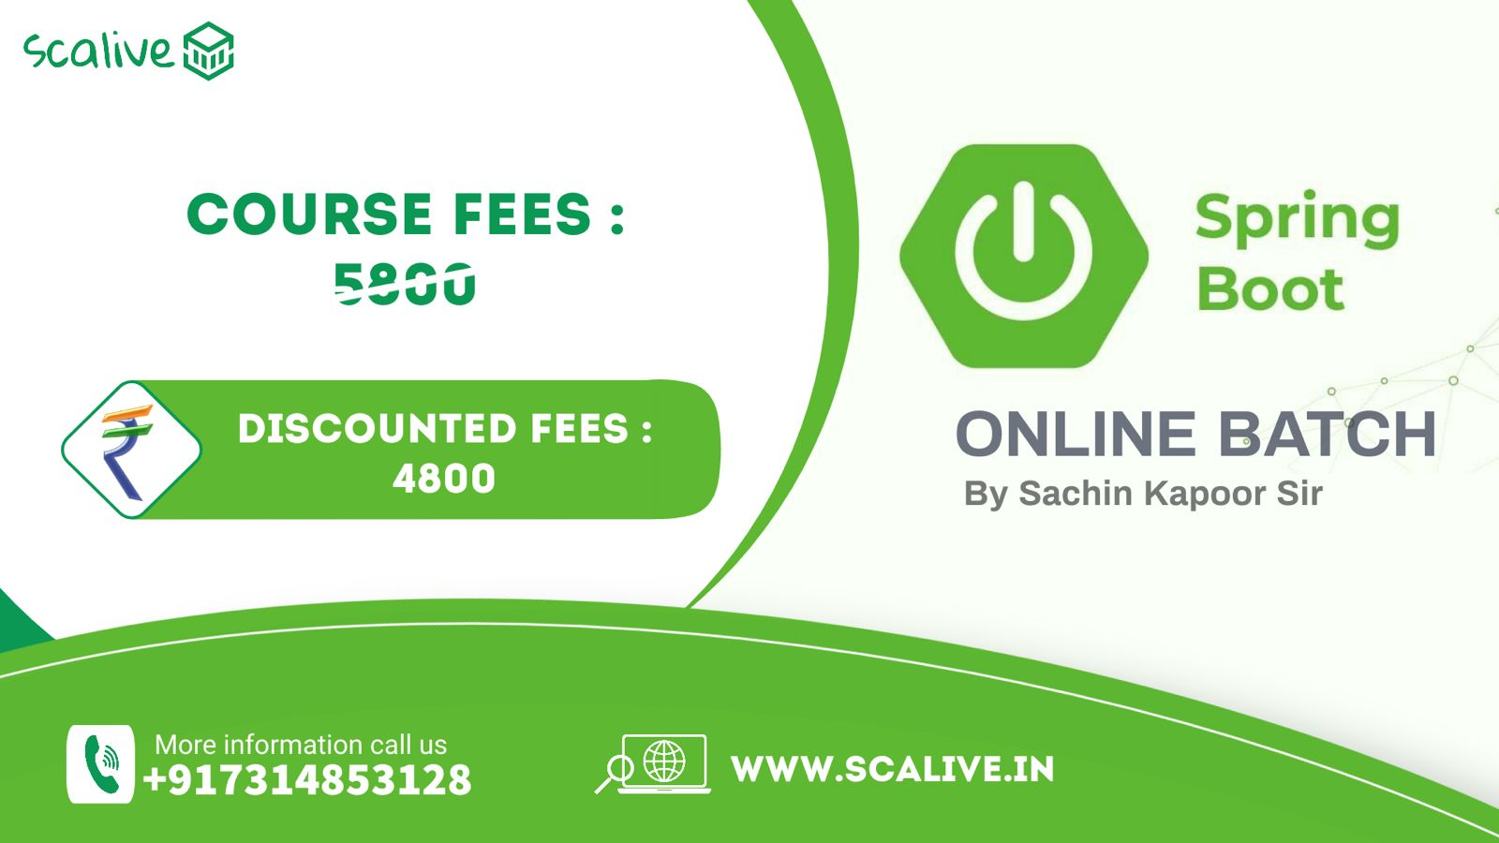
Course Fee

Slide 24
THANK YOU
www.scalive.in

